Slide 1
Illusions in Art
Packet 1-18

Slide 2
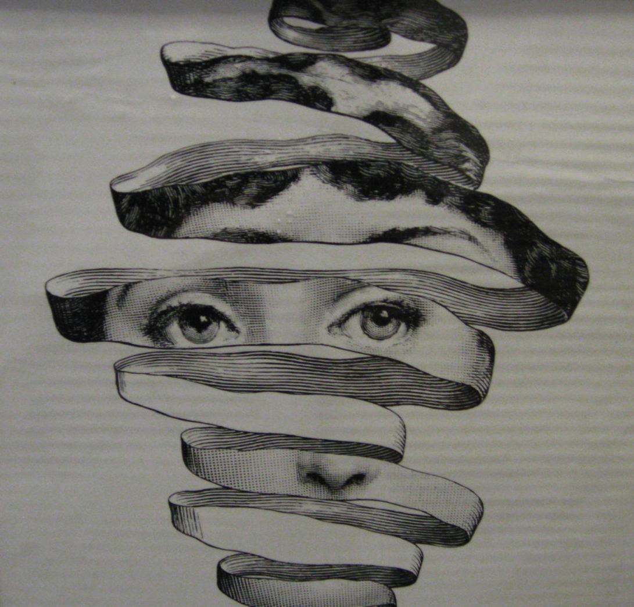
“Theme and Variations No. 297″ by Piero Fornasetti. Lithograph.
Notes:
“Theme and Variations No. 297″ by Piero Fornasetti. Lithograph.

Slide 3
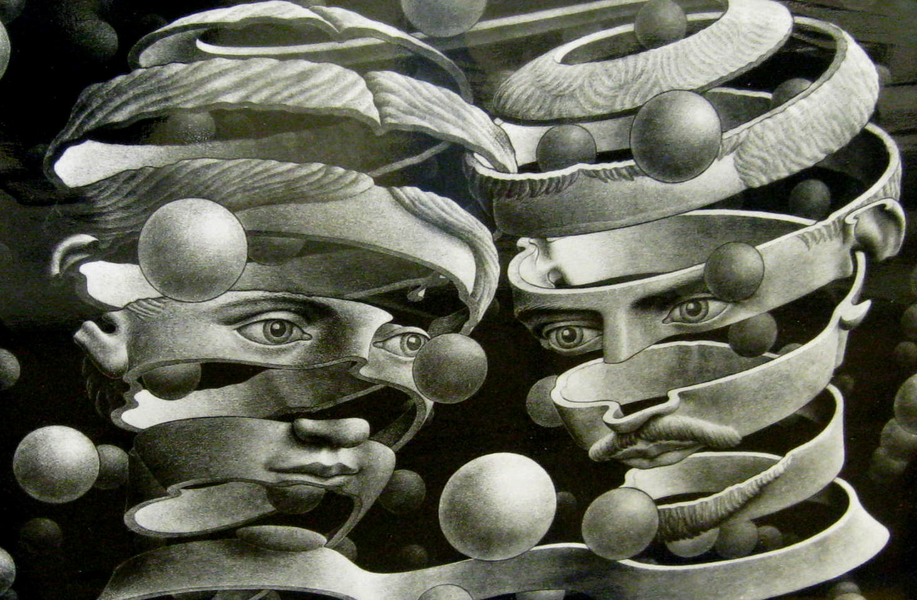
“Bond of Union” by M.C. Escher (1956)
Notes:
2. “Bond of Union” by M.C. Escher (1956)

Slide 4
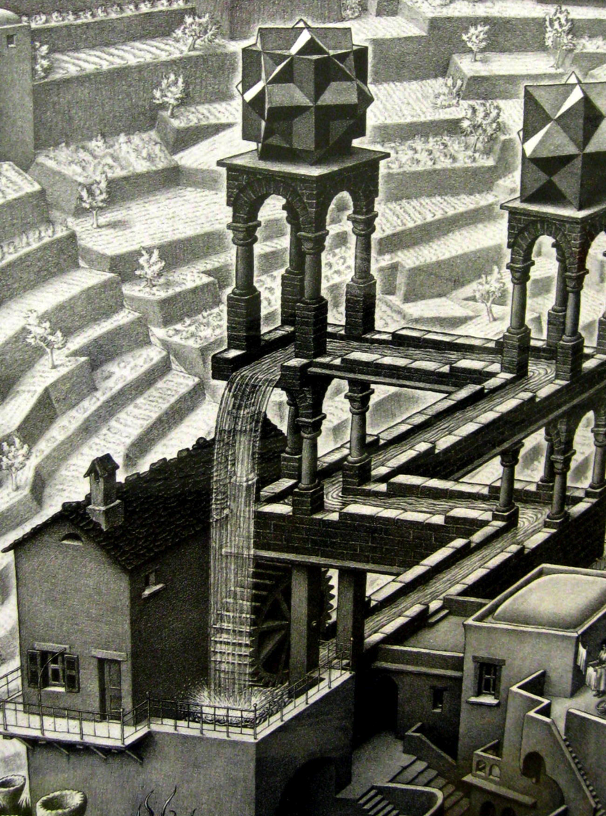
“Waterfall” by M.C. Escher (1961)
Notes:
3. “Waterfall” by M.C. Escher (1961)

Slide 5
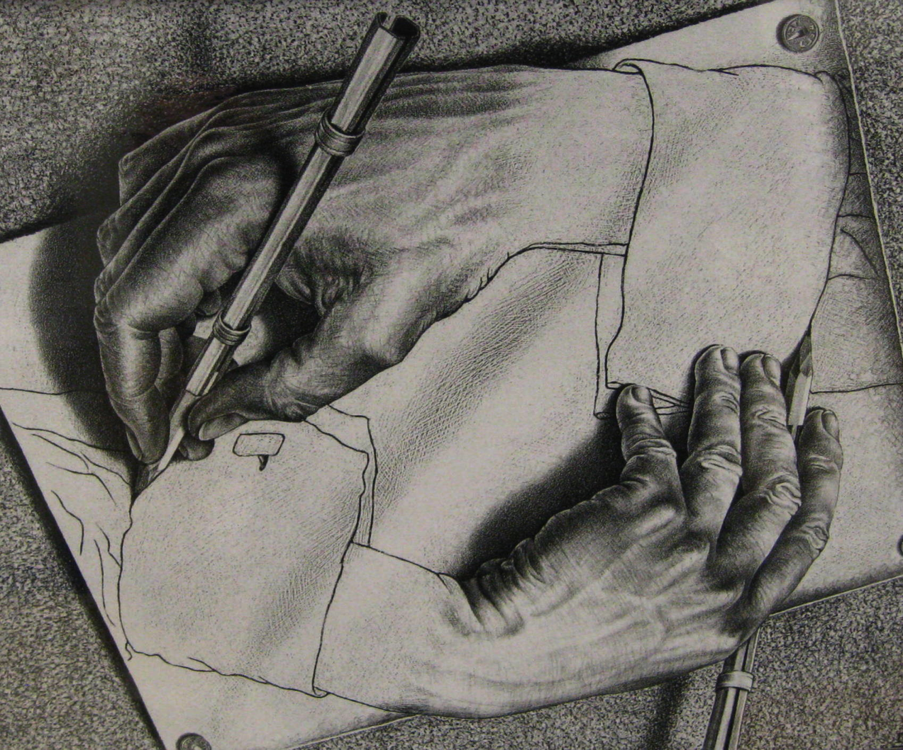
“Drawing Hands” by M.C. Escher (1948)
Notes:
4. “Drawing Hands” by M.C. Escher (1948)

Slide 6
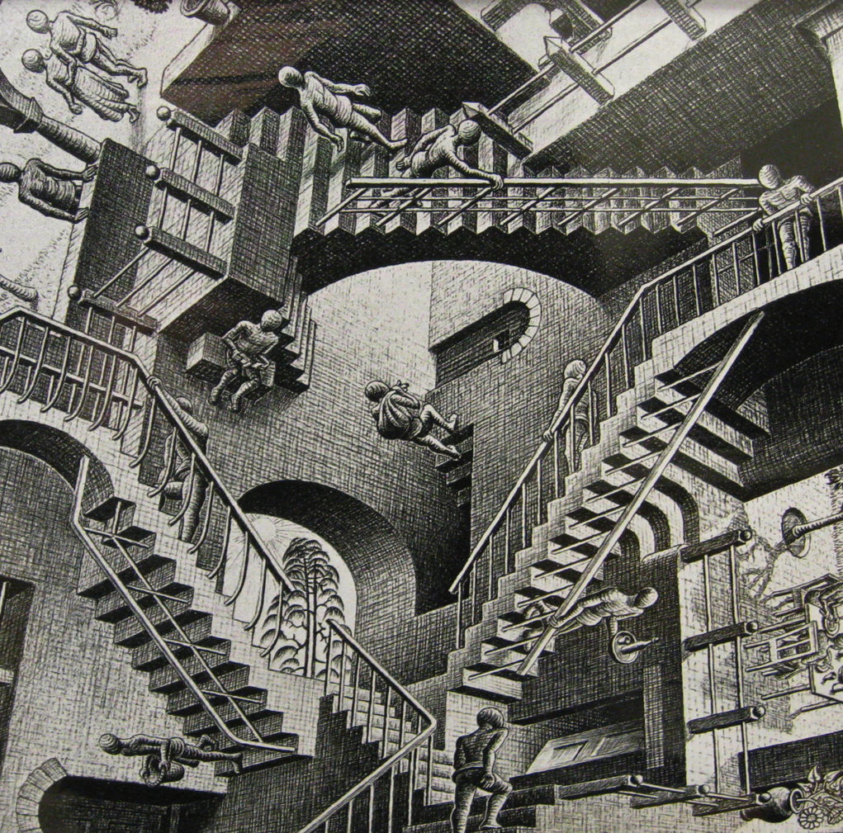
“Relativity” by M.C. Escher (1956)
Notes:
5. “Relativity” by M.C. Escher (1956)

Slide 7
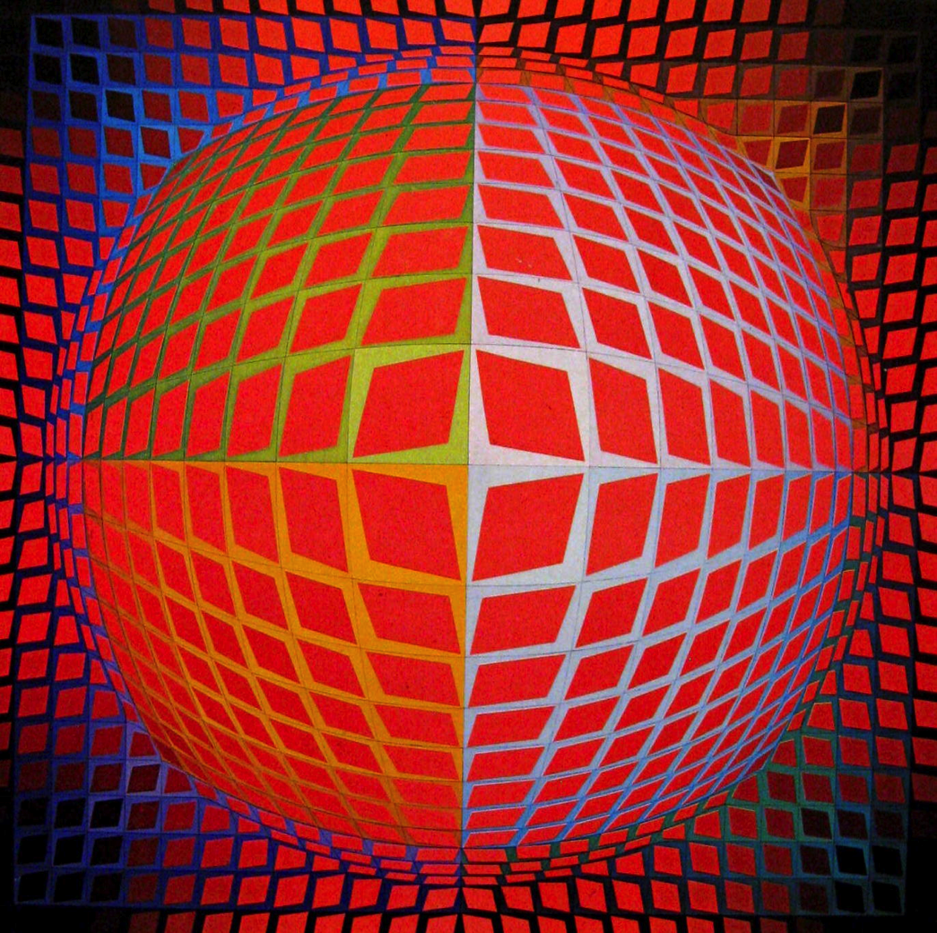
“Vega-Kontosh” by Victor Vasarely (1971)
Notes:
6. “Vega-Kontosh” by Victor Vasarely (1971)

Slide 8
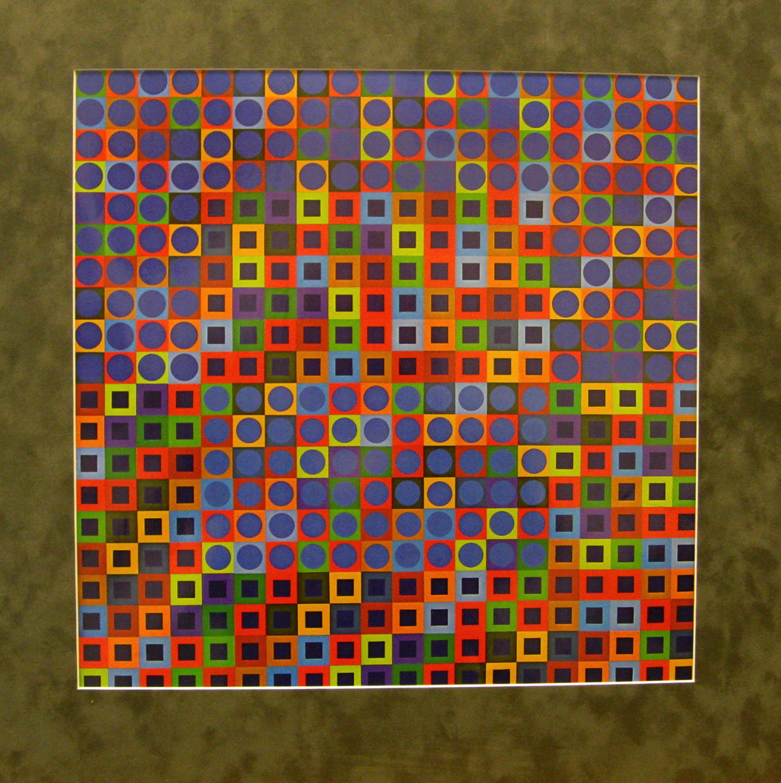
“Zebegen” by Victor Vasarely (1964)
Notes:
7. “Zebegen” by Victor Vasarely (1964)

Slide 9
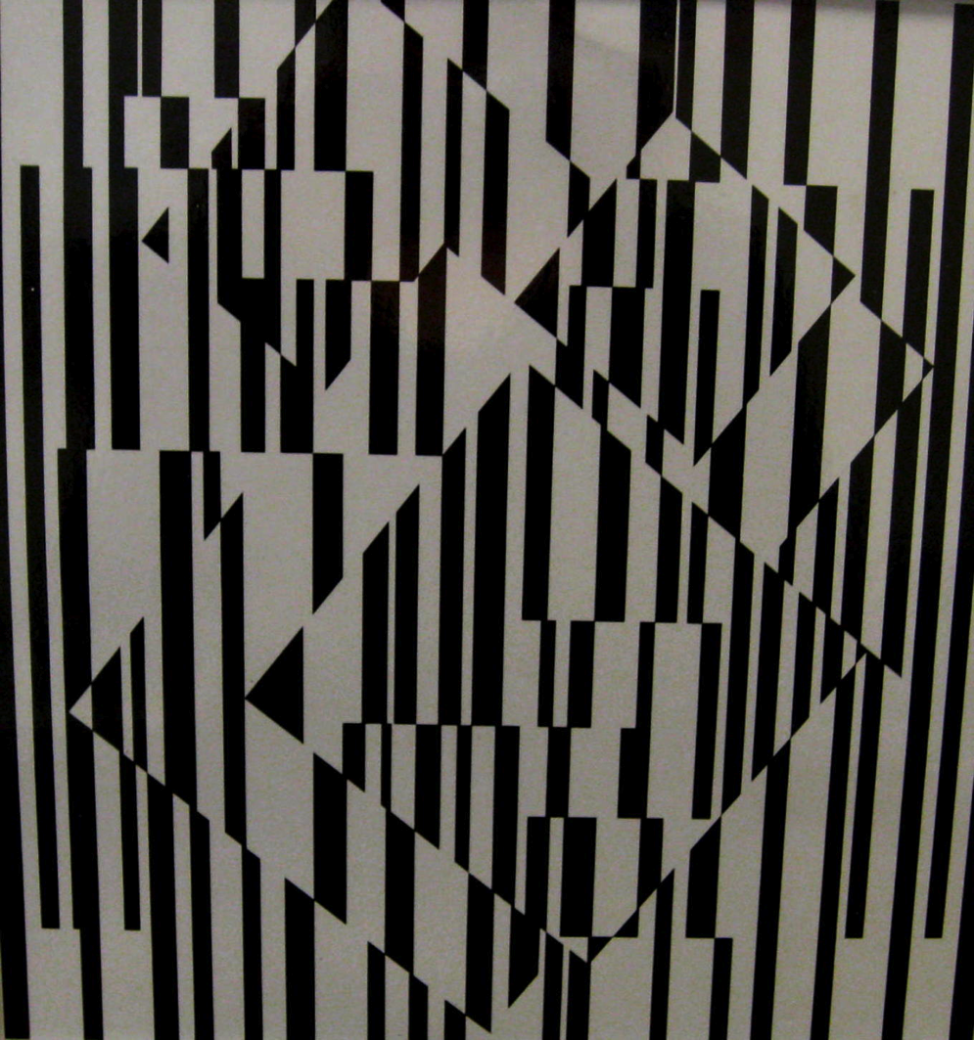
“Black and White” by Victor Vasarely. Oil on wood.
Notes:
8. “Black and White” by Victor Vasarely. Oil on wood.

